Slide 1


MeetHub
Meeting Room Booking System
Presented by Selcan Zeynalova

Slide 2

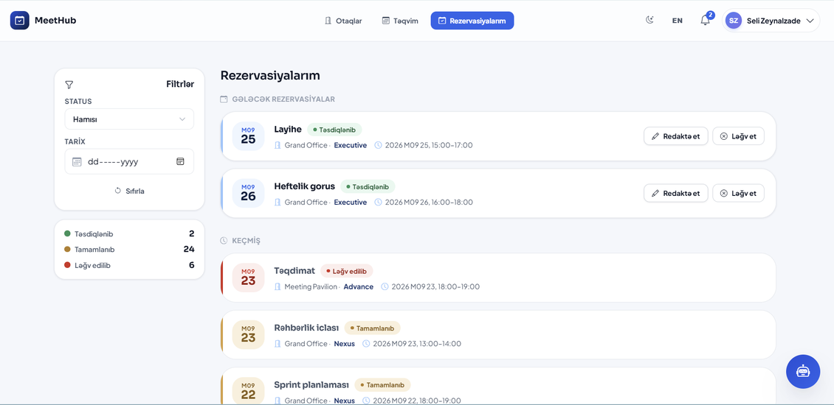
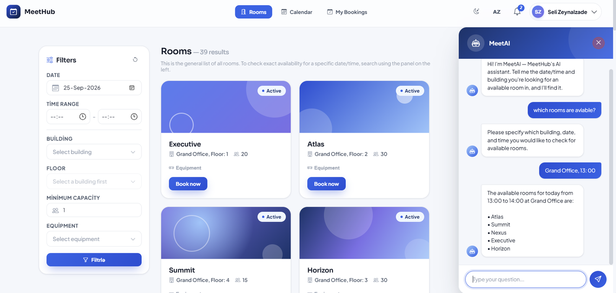

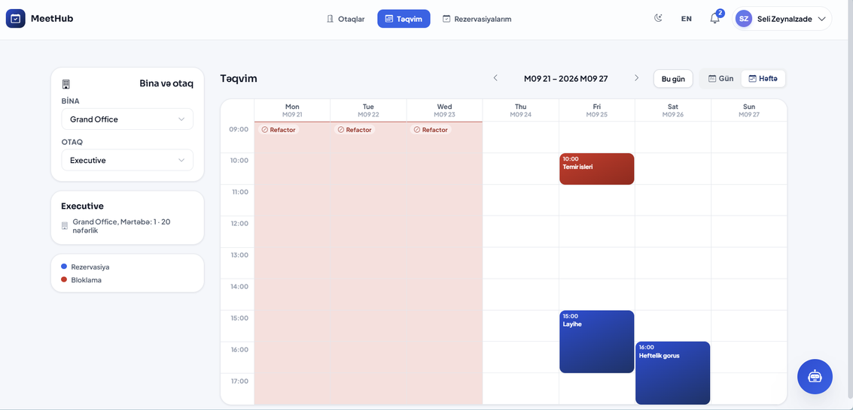
What is MeetHub?
MeetHub is a web-based meeting room booking and management system designed to simplify how organizations manage their meeting spaces.
It allows users to:
  Find available meeting rooms
  Create and manage reservations
  Check room availability with AI
  Manage their bookings

Slide 3

  Technical Stack
Backend
Frontend
  ASP.NET Core Web API
  Entity Framework Core
  SQL Server
  ASP.NET Core Identity
  2FA (Gmail SMTP)
  JWT Authentication
  SignalR
  Fluent Validation , AutoMapper
  xUnit / Moq / FluentAssertions
  Serilog
  Google Gemini AI API
  HTML
  CSS
  JavaScript, Fetch API
  Bootstrap
  Chart.js
  AZ / EN localization
  Dark / Light Mode

Slide 4

  Manage buildings and floors
  Create, update and deactivate meeting rooms
  Manage room equipment, blackouts
  View and manage all reservations
  Manage users and their roles
  Manage system settings, working Hours
  View system statistics and real-time updates
Admin
  Browse available meeting rooms
  Search rooms by availability and capacity
  Create reservations
  View personal reservations
  Edit or cancel own reservations
  Calendar view of reservations
  Interact with the AI chatbot
User

Slide 5
F1.
Room Catalog
Rooms include name, floor, capacity, and available equipment.
F5.
Room Calendar
A calendar view displays room bookings for each day.
F2.
Real-Time Search
Users can search for available rooms by date, time range, and capacity.
F6.
Conflict Detection
The system automatically prevents overlapping reservations.
8 Main
  Features
F3.
Booking Creation
Users can create bookings with a meeting title, participants, and duration.
F7.
My Bookings
Each user has a personal dashboard to view and manage their bookings.
F4.
Booking Modification & Cancellation
Users can modify or cancel their own reservations.
F8.
Admin Management
Admins can manage rooms, floors, and equipment inventory.

Slide 6
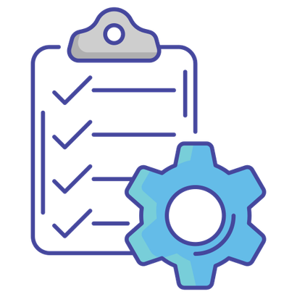
Additional Features
AI-Powered Chatbot
  Integrated with Google Gemini AI
Logging & Exception Handling
  Serilog-based logging and centralized exception middleware
Admin Analytics Dashboard
  Reservation statistics, visual charts
Timezone Management
  Centralized UTC and Asia/Baku timezone handling
Real-Time Updates with SignalR
  Live reservation updates on the Admin Dashboard
i18n - internationalization
  AZ/EN Languages
Dark/Light Mode

Slide 7

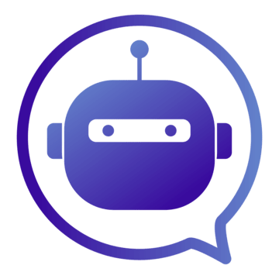
Real-Time and AI Integration
Real-Time Communication
  SignalR integration
  Live room calendar updates
  Instant updates when reservations are created, updated, or cancelled
  Automatic synchronization across open calendar views
AI Assistant
  Google Gemini AI integration
  Conversational room search
  AI can search real room and building data
  Function calling connects the AI assistant with backend services

Slide 8

Conclusion
MeetHub is a complete meeting room management platform designed to make room booking simpler, smarter, and more efficient.
https://meethub-mrbsystem.netlify.app

